Slide 1

Towards a
Dorset Local Area Energy Plan
Introduction and invitation to participate
In late 2023 and early 2024, Place & Resources Scrutiny Committee held a cross-party inquiry into grid constraints, chaired by Cllr Shane Bartlett.
Its recommendations – subsequently approved by Cabinet – included developing a local area energy plan and working more strategically with network operators.
It is now timely to progress with some of these recommendations given national context, and we’ve commissioned Regen and the Centre for Sustainable Energy to support us.
In this introduction, we’ll overview the context – explaining (i) why you should care, (ii) what we’re intending to do, (iii) why we’re doing it now, and (iv) how we’d like you to be involved.

Slide 2
Summary
The energy system, how it is planned, and how it is funded are all changing. This presents an opportunity for us to have more strategic influence on energy planning in support of our Council Plan objectives.
A new national framework for strategic energy planning is emerging, including the forthcoming establishment of ‘Regional Energy System Planners’ (RESPs) – whose Board we’ll sit on, and which will create a regional plan.
It is now timely to begin thinking about how we prepare for the South West RESP – how we can upskill, work together, share data, represent local stakeholders, and articulate our asks.
One way to prepare would be to create a Local Area Energy Plan (LAEP). Many areas already have done so.
But we shouldn’t rush, as many existing LAEPs have been expensive but not very impactful. Before going too far with expensive modelling/forecasting, we should carefully reflect on our role in delivery, how we add value to and influence the RESP and network operators, and how we can update a plan in the future.
We have commissioned Regen and CSE to support us in taking the initial steps for a LAEP: visioning, baselining, and creating a data repository. This will take place from March to July, and we strongly encourage internal teams to participate.

Slide 3
Why care about energy planning?
1. The energy system is changing:
Generation is becoming more decentralised.
Electricity demand is forecast to more than double by 2050.
That requires much more generation, storage and grid infrastructure.
The grid is already constrained – impeding development, economic growth and net zero.
2. How the grid is planned and invested in is changing:
Major investment is needed in the grid to grow capacity.
It was previously upgraded only reactively – but we’re now moving towards more long-term forecasting and anticipatory investment by network operators.
That’s not just happening at the national scale: new regional energy planners are emerging.
3. The funding landscape for local energy is changing:
Government has committed to 8GW of local and community energy projects through its ‘Local Power Plan’ and GB Energy.
They’ve pledged £400m/yr in low-interest community loans, and £600m/yr of council grants.
The National Wealth Fund and devolution might unlock more opportunities too.
Our Council Plan ambitions are powered by energy. Development, growth and net zero all depend on getting energy infrastructure in the right place at the right time.
Local influence and clarity on our ambitions is needed to help steer strategic energy planning and attract & direct investment to exactly where it is needed.

Slide 4
What is ‘strategic energy planning’?
‘Strategic energy planning’ is about clarifying our future needs & ambitions for energy infrastructure.
It clarifies ambitions for what, where, and when we need generation, storage and grid infrastructure to meet our needs.
It should give sufficient clarity and certainty to inform investment decisions.
Nationally a new framework is emerging…
Government’s
Clean Power 2030 Plan
Other linked factors:
Future Energy Scenarios (FES) - Net zero pathways analysis
National
Strategic Spatial Energy Plan (SSEP)
A blueprint for large-scale generation and storage of electricity and hydrogen (draft due Q2 2026)
Centralised Strategic Network Plan (CSNP)
A long-term plan for transmission network infrastructure (methodology consultation Q2 2025)
Holistic Network Design (HND) - Offshore wind coordination
Gas network planning (GNCNR and GOAD)
Electricity market reform (REMA)
DNO Distribution Future Energy Scenarios (DFES), RIIO-ED Business Plans (5yr), and Network Development Plans (10yr)
Regional Energy Strategic Plan(ner)s (RESPs)
New and emerging sub-national whole energy system planning and governance
Regional
Connections Reform
Marine Spatial Prioritisation Programme
These are the two we need to immediately consider
Crown Estate’s Whole of Seabed Programme
Local Area Energy Plans (LAEPs)
Local
Land Use Framework

Slide 5
Regional Energy Strategic Plan(ner)s?
What?
RESPs are being set up by the National Energy System Operator (NESO). They’ll develop regional energy plans through new regional ‘Strategic Boards’ – with democratic representatives from tier 1 authorities – and be supported by working groups.
Why?
They will help to connect councils and network companies to better coordinate regional energy planning and direct network investment for all energy vectors (i.e. not just electricity)
How?
We’ll play a role by:
Sharing data from our local spatial and data-led plans
Visioning to help us set their regional vision and direction
Decision-making through the regional Strategic Board
The outcomes and process could benefit our ambitions on planning, economic growth, housing, transport, waste and net zero.
It could better attract and direct investment, enable better policy, and nurture partnerships.
It is an opportunity to add value and have more strategic impact on the future energy system.
When?
Regional forums established
Transitional pathway consultation
Transitional
output published
Regional Boards established
RESP publication
Q1
Q2
Q3
Q4
Q1
Q2
Q3
Q4
2025
2026
2027
Ofgem RESP
consultation outcome
Regional launch events
Methodology consultation
Draft SSEP consultation
SSEP
publication

Slide 6
How do we prepare for the RESP?
To prepare for the RESP we’ll need to consider five things…
1. Knowledge
How do we build up knowledge amongst officers and members so that we can effectively participate (building on the scrutiny grid inquiry and subsequent member webinar)?
2. Internal working
Do we need to develop internal working groups or governance to ensure that our representatives to the RESP have the right info and can speak in a consistent voice?
3. Data sharing
How should we collect and share relevant, accurate and up-to-date data to articulate and evidence our needs and aspirations on what, where and when we want energy infrastructure?
4. Stakeholders
How should we approach representing local stakeholders, so that we can be an effective conduit for local community, business and stakeholder views to the RESP?
5. Our asks
Do we have yet have a clear enough vision and set of asks about what we even need or want? If not, how do we clarify such?
The RESP may eventually provide some support with:
Technical advice on developing local energy plans
Coordinating plans at different scales
Sharing good practice
Training on the energy system
Improving data consistency
One way to prepare would be to start creating a Local Area Energy Plan. Some areas already have one (including BCP), and there’s a risk we’ll be less able to articulate our asks and engage strategically with RESPs and DNOs without one.
But how can we ensure a LAEP is impactful?

Slide 7
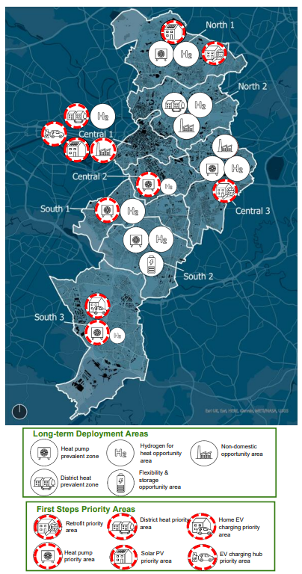
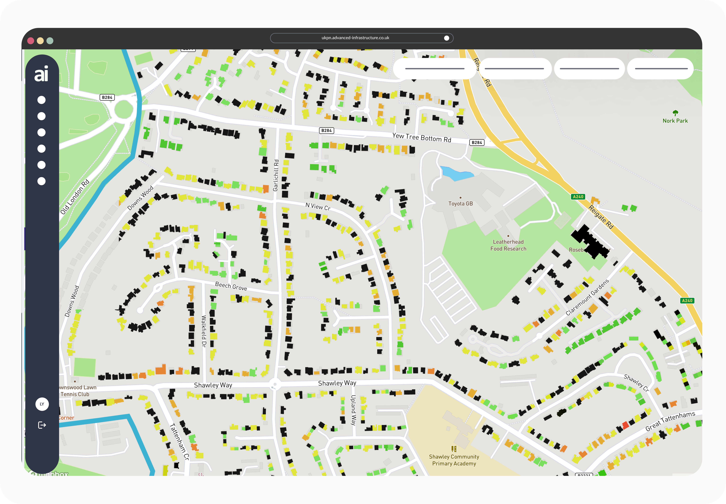
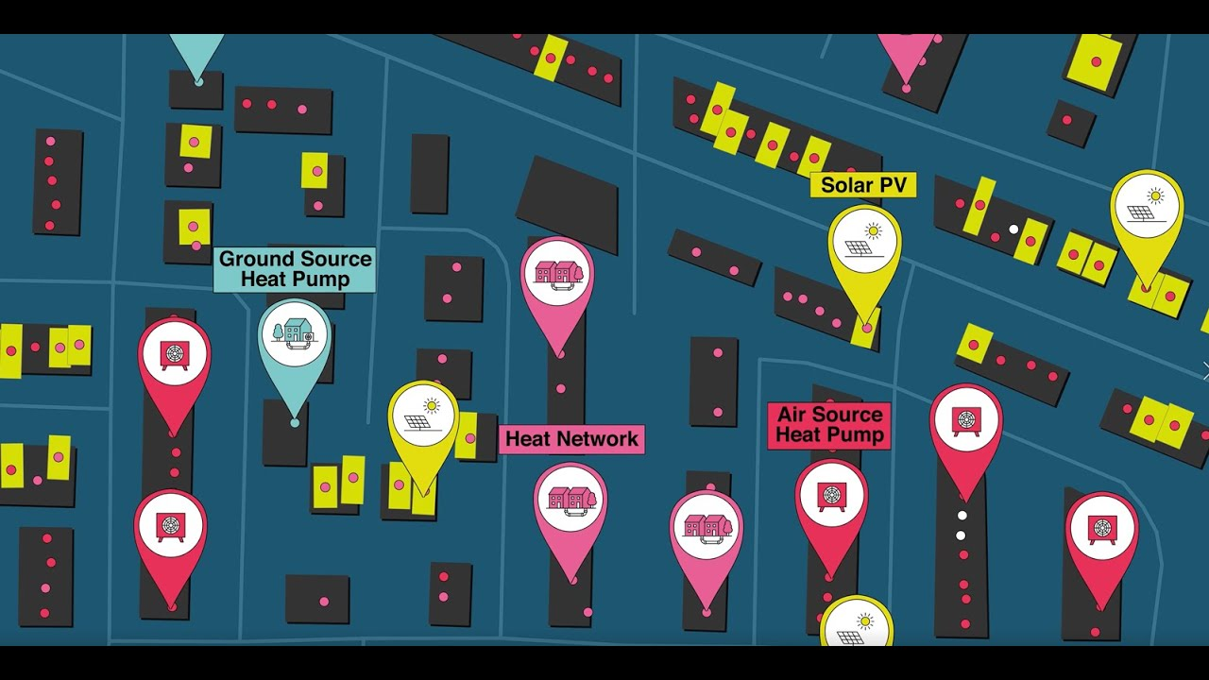

What is a ‘Local Area Energy Plan’?
LAEPs are spatial plans that clarify & evidence what, where and when energy infrastructure is needed at a local scale.
Based on data and engagement, they help clarify uncertainties, opportunities, challenges on technical matters and costs to guide decision-making and investment.
They’re relatively new – the first was Manchester’s in 2021.
There’s no statutory requirement in England to produce one, but around 1 in 6 councils have – but with largely inconsistent methods and to varying levels of detail.
  You can view Manchester’s LAEP here
  BCP’s should be available very soon

Slide 8
What should a LAEP not do?
But plans aren’t action, and many LAEPs haven’t been massively impactful to date as it’s not been clear who or what they’re for – but the emergence of the RESP can change that. We’ve been cautious to progress too fast for this reason. Many have fallen short due to:
Weak delivery-focus:
A lack of clarity on the council’s specific roles in their implementation.
Weak embedding:
Disconnection from other council functions and a lack of embedding in other strategic plans, decision-making or delivery programmes.
Weak influence:
Lack of a formal route to influence DNOs; and methodologies inconsistent with their DFESs – resulting in disconnection and duplication.
Inconsistency:
Inconsistent methods (regarding datasets, modelling assumptions, archetypes, units and granularity) that impairs their influence, comparability, commensurability and aggregation across areas.
Imbalance:
Granular detail in areas we’ve less influence over and poor steer where we do – as well as over-emphasis on forecasting & modelling, rather than specifying tangible, investible opportunities.
Obsolescence:
LAEP modelling that often quickly goes out of date – and is then expensive to replicate/iterate.

Slide 9
What should a LAEP do?
Given those observations, ensuring a LAEP is impactful requires considering three key things that should shape the method and format of the outputs:
1. Our sector-specific delivery roles
2. How it will inform and add value for the RESP and DNOs
3. How it can be dynamic and agile
The level of detail should fit its use for facilitating delivery – so we should spend time reflecting on our anticipated roles in delivery for specific sectors (e.g. in renewables, transport, industry, bioenergy, heat networks, retrofit etc.). That might consider:
Direct delivery (e.g. on our own estate or beyond)
Embedding in policy or delivery programmes
Acting as a convenor where we’ve less direct influence (e.g. industry, large-scale generation)
It should serve the RESP and DNOs in order to be impactful and avoid duplication, by:
Focusing on specifying & prioritising tangible investible opportunities grounded in insight/evidence, rather than yet more long-term forecasts.
Use data repositories, modelling assumptions, archetypes, units and granularities that align with DFESs, RESPs and allow cross-area comparability & aggregation.
Clarify ambition in abstraction from grid capacity or constraint costs - to inform RESPs/DNOs on where we want timely provision of capacity.
It needs to be dynamic and agile rather than static – and updated something like 5 yearly at minimal cost.
The most promising way to do this would be to utilise our access to ‘LENZA’, a spatial energy planning tool from SSEN which we currently have a license to. Using that would make it easier to iterate the plan, and also enable efficient data flow with SSEN to inform their DFES. (We’d also need to consider the approach for NGED).

Slide 10
How should we proceed?
Given the above, we should proceed carefully and iteratively in order to best align with the emerging needs of the RESP, through the following process:
High-level energy baselining and creation of a data repository
Characterisation of our role in delivery for each sector
Visioning to clarify our priorities, especially near-term priorities
Refinement of detail, with development of modelled pathways where suitable
We’re only progressing these first stages presently. We’ll then reflect on how to progress the fourth. This is for three reasons:
We want to ensure that any detail and modelling fits with the RESP’s needs (e.g. on datasets and units, modelling assumptions, archetypes, & granularity).
We want to better explore the extent to which we might do the fourth in-house just using LENZA.
We want to clarify the extent to which detailed modelling/forecasting is a useful component at all – or whether we should jump straight to developing a near-term investment prospectus/pipeline.
The second stage is critical – we want to explore not just our ambition for outcomes, but our ambitions for our role in delivery.
That means taking time to discuss and characterise our needs and appetites on things like:
Capabilities and capacity building
Leadership and governance
Policy embedding
Relationships, partnerships & reputation
Funding and finance
Delivery bodies and commercial structures

Slide 11


What are we trying to produce now?
We’ve commissioned CSE and Regen to support us through these stages.
Over the next five months to July, we aim to develop 5 outputs:
1. Vision
A statement of ambition which incorporates and builds upon existing objectives/targets.
A draft will initially be agreed with senior leaders internally, then refined with further local stakeholders.
2. Baseline part 1: Local Area Characterisation
A non-technical analysis of (a) the enabling context (policy, financial and economic conditions and stakeholder interest); (b) our capability and appetite for delivery; (c) key local/regional stakeholders and their roles.
3. Baseline part 2: Baseline Energy Representation
A technical (technology and intrastructure) and non-technical (social, economic, regulatory) representation of the current local energy system, along with a methodology statement and gap analysis.
4. Data repository:
Collation of relevant national and local datasets for retention and storage for future use. Data will be collated in the discovery phase alongside discussion of the functionality of the repository, which will subsequently be developed.
5. Forward plan:
A roadmap outlining next steps for further LAEP development, including detail of resourcing.
Jointly commissioning this work through the SW Net Zero Hub with three other SW local authorities will also support our alignment, and engagement with NESO and the DNOs – whilst also offering lessons to other local authorities.

Slide 12
What’s the plan and timelines?
Phase 1 (March-Apr)
The three internal team meetings will respectively:
Map stakeholders and steer the project
Review engagement findings and finalise the vision
Decide on next steps
The key stakeholder interviews (4-6x) and senior leaders workshop will interview key priority strategic stakeholders (internal or external) to understand their role and ambitions.
Internal team meeting *
Early March
Key Stakeholder interviews *
March
Senior leader workshop *
Late March/Early April
Comms & engagement plan
Baseline documents
Draft Vision
Phase 2 (May)
2x Engagement workshops
Early May
Stakeholder survey
May
Internal team meeting *
Late May
The engagement workshop and survey will further clarify priorities and roles from a wider set of stakeholders.
The regional webinars and local working groups will further learn and explore issues on governance, finance, delivery and comms.
Final Vision, Data repository and methodology/gap analysis
Phase 3 (June-July)
4x Regional webinars
Late June
2x Local working groups
Early July
Internal team meeting *
Late July
*Representatives of internal teams are encouraged to at least join the internal team meetings and senior leader workshops – and we may ask to dig into some issues with you through the key stakeholder interviews.
Forward Plans
Possible launch webinar

Slide 13
Our asks of you
Engagement
1. Please nominate an officer from each area to participate in the 3x Internal Team meetings (March, May, July).
2. Please nominate a senior leader from each area to participate in the Senior Leader Workshop (late March/early April).
3. Please take the opportunity to engage in the webinars and working groups in Jun/Jul on governance, finance, delivery and comms. We’ll clarify who may want to participate nearer the time.
Sharing information (via the spreadsheet)
4. Please mention any stakeholders you think may be relevant to the spreadsheet.
5. Please help us identify any relevant local datasets. We don’t need to actually share the data now – we just want to identify what there is, its format, and any usage limitations.
6. Please let us know of any relevant documents (plans, strategies, reports etc.).

